Slide 1


QuickLearning App
Capstone Project
Guided By Professor Henry Wong

Slide 2


Agenda
Accountabilities
Project Description
Team Working Agreement
Personas
MVP
Technologies
Algorithm
Diagrams
Sprint 1-4 Recap
Sprint 5-7 Recap
Project Recap
Product Backlog
Sprint Backlog
User Stories
Test Cases
Stories Completed and Not Completed
Metrics
Retrospective
Improvements Made
Future Enhancements
Slides App Screenshot
WikiLink
Live Application Demo

Slide 3

Accountabilities

Slide 4



SHARANYA DAVE
Database Administrator
SRAVANI EATA
Software Tester
USHA SRI TIRUMALASETTY
Team Manager

Slide 5



AMIT BHAYAL
Software Developer
ANKUSH RAJESH GURHANI
Software Developer
GENIUS MACHADO
Quality Analyst

Slide 6
Project Description

Slide 7
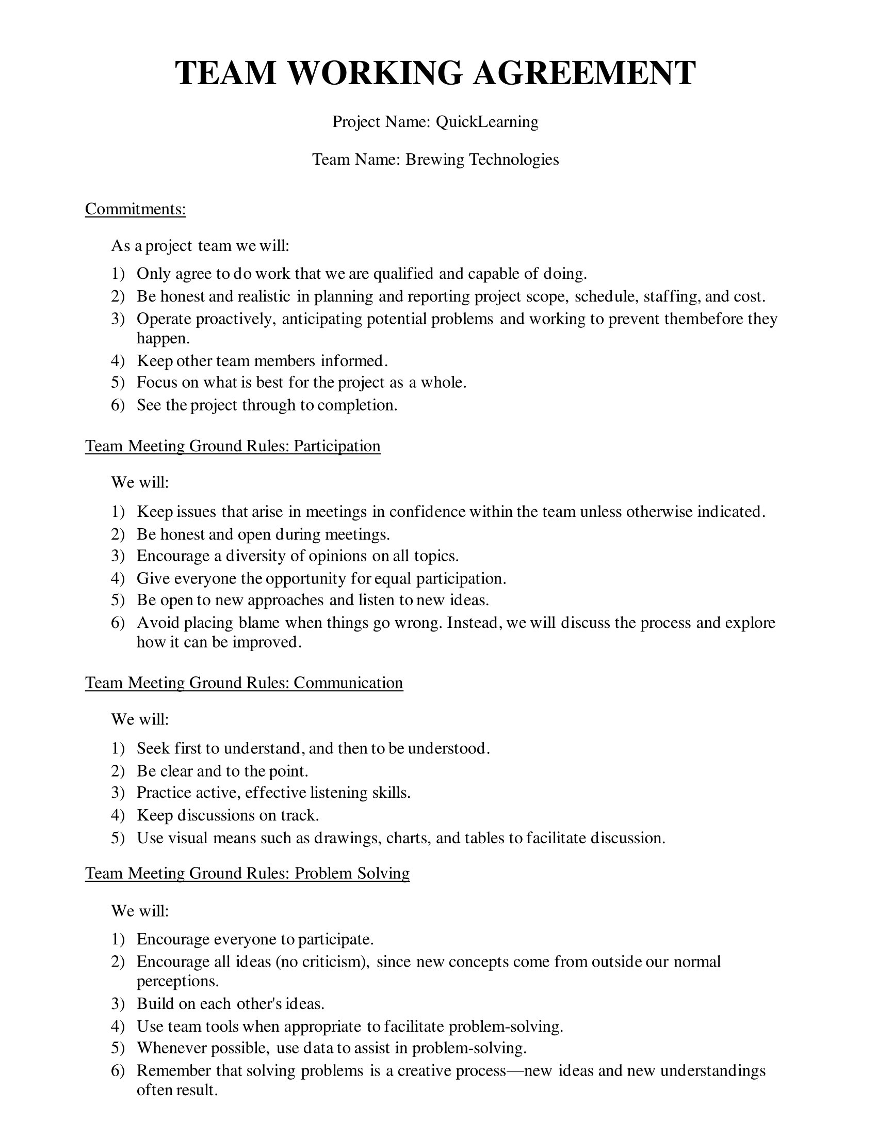
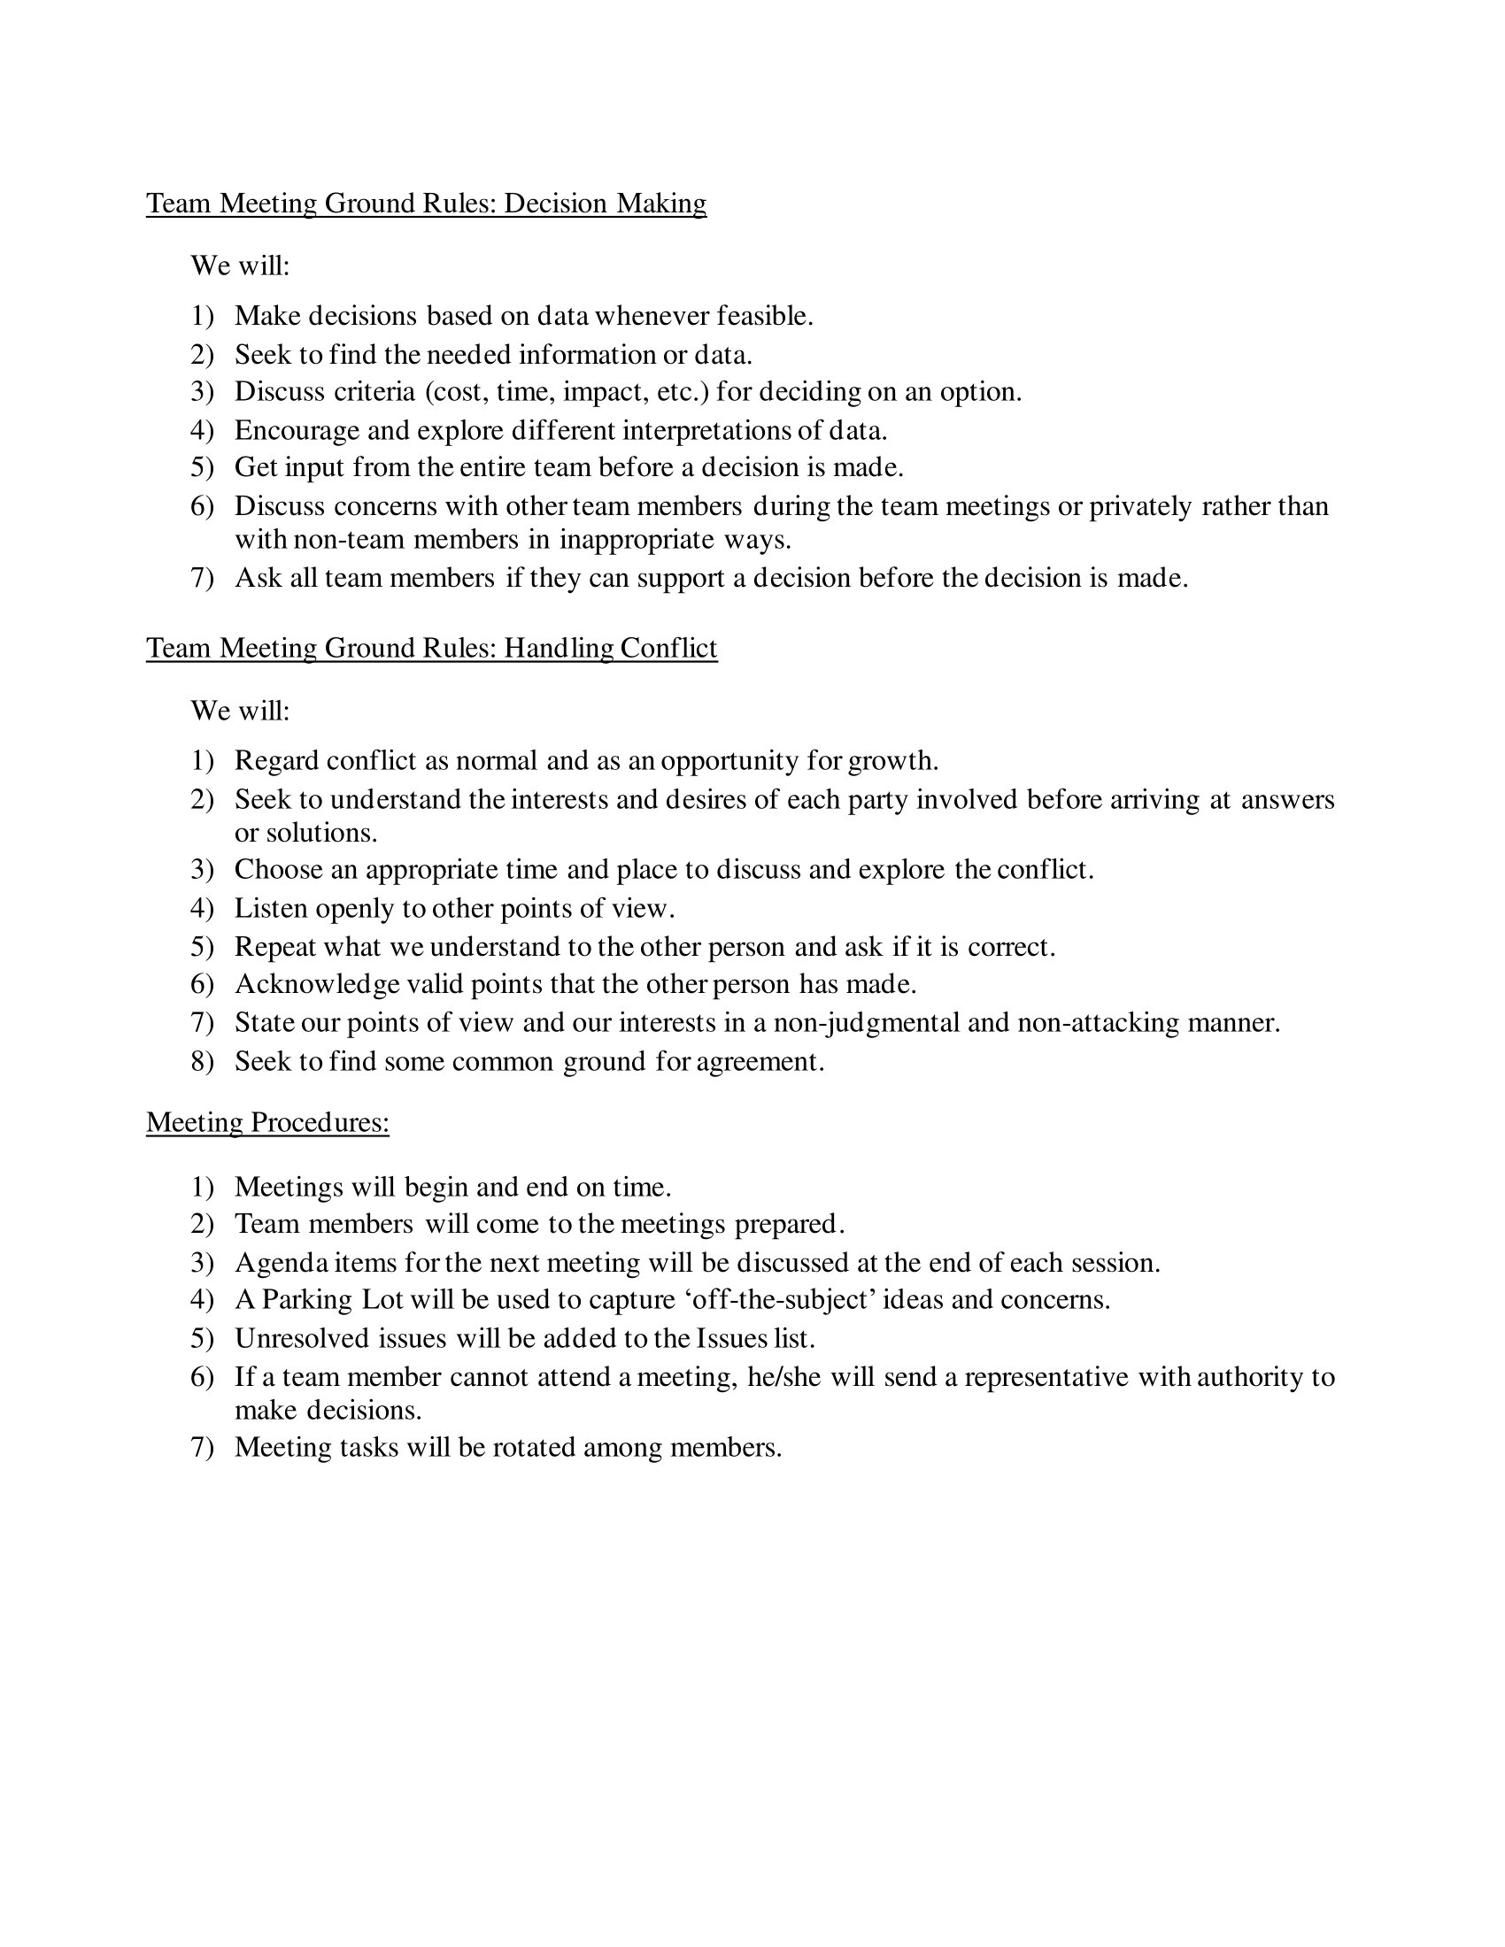

Slide 8

Personas

Slide 9
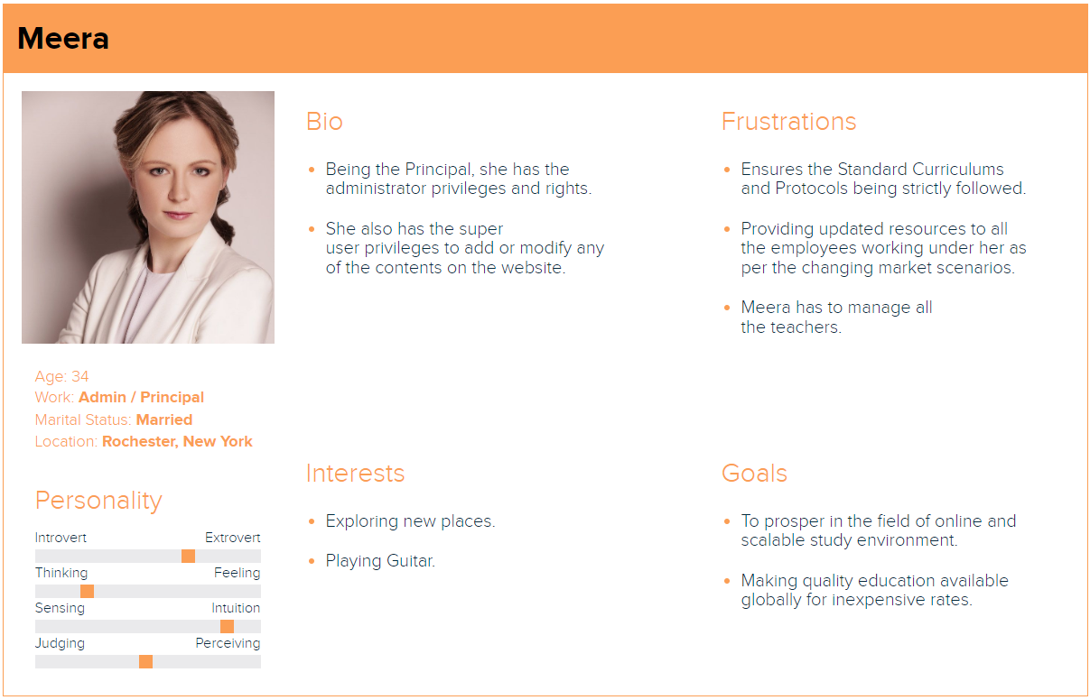

Slide 10
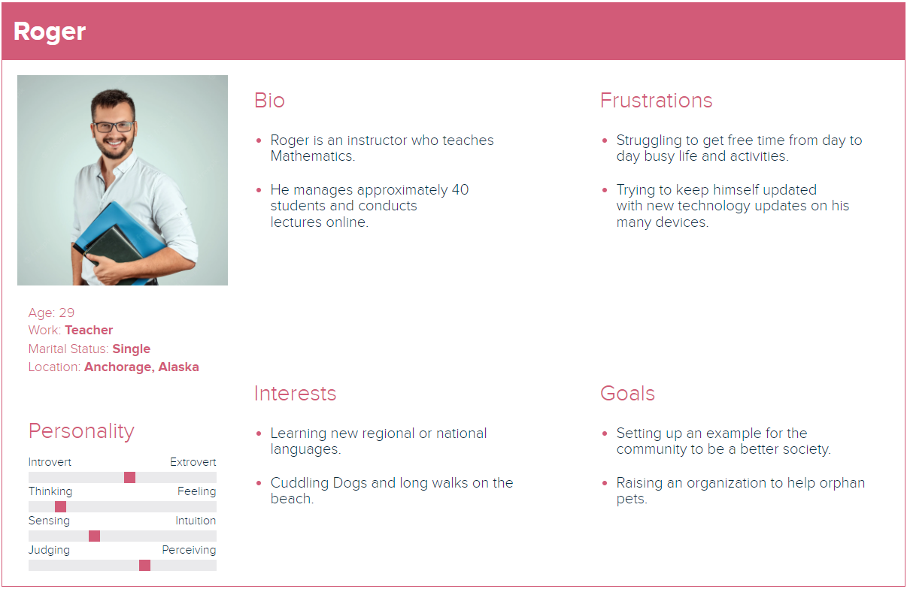

Slide 11
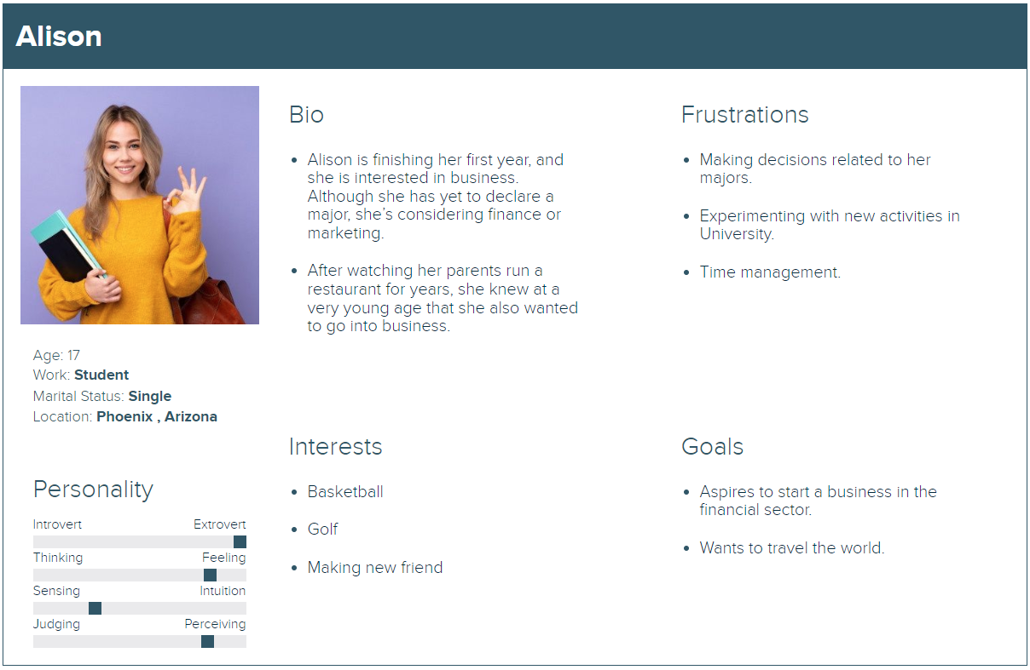

Slide 12
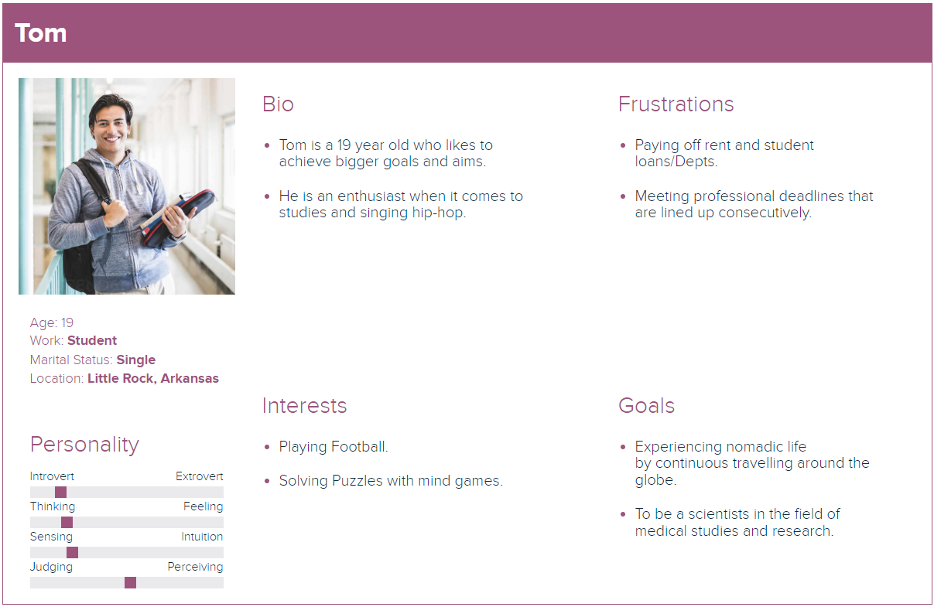

Slide 13
Minimum Viable Product (MVP)
QuickLearning MVP
Registration
Homepage
Admin Dashboard
Instructor Page
Course
Login
Search Bar
Categories
Revenue
Add/Remove Course
Logout
Top 10 Courses
Students
Courses
Add/Remove Categories
Forgot Password
Course Catalogue
Report
Payment Settings
Course Overview

Slide 14
Technologies

Slide 15
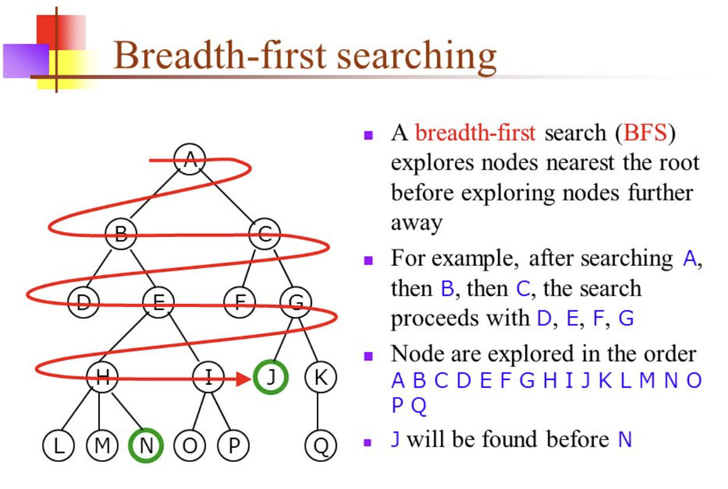
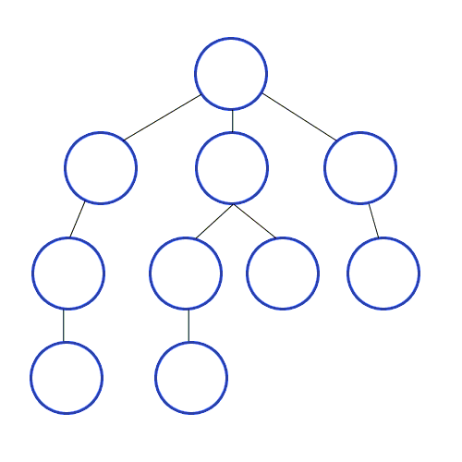
Algorithm

Slide 16

Diagrams

Slide 17
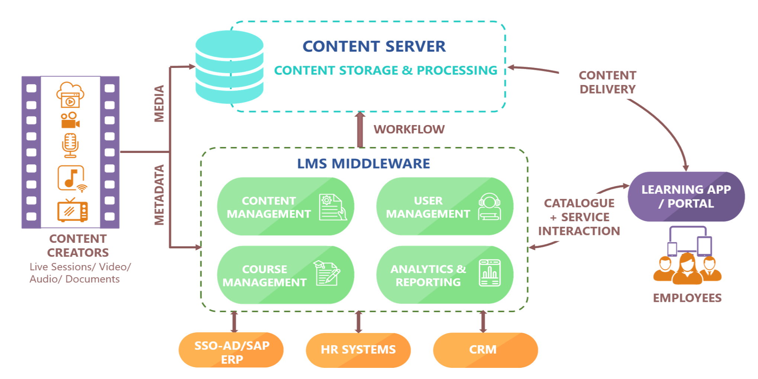
Conceptual Architecture Diagram

Slide 18
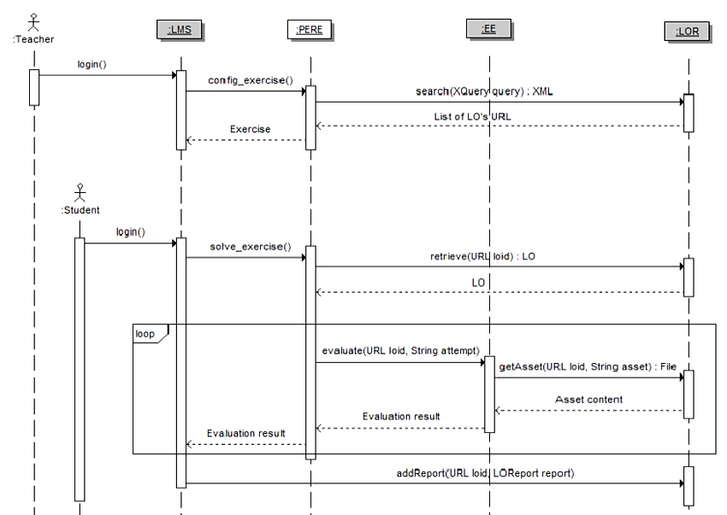
Sequence Diagram

Slide 19
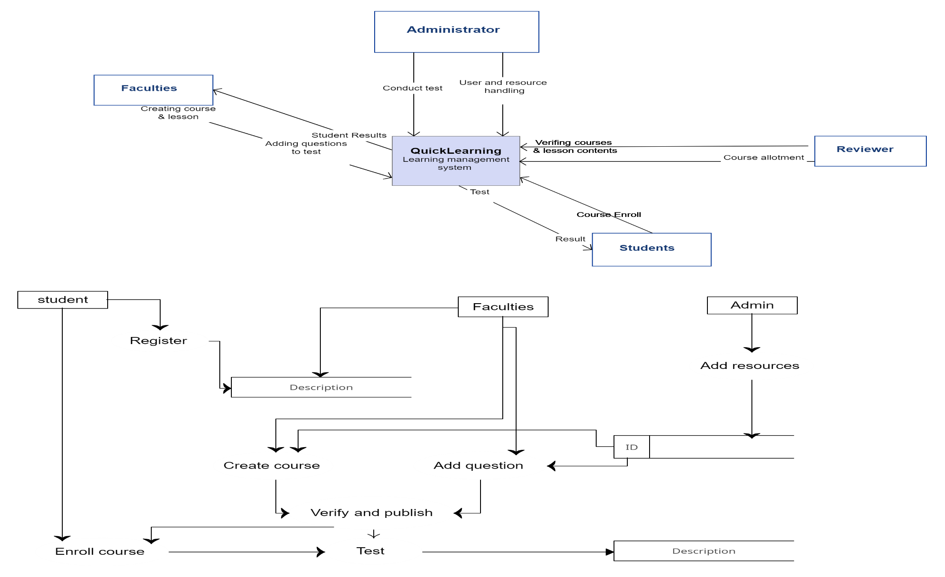
Context Diagram

Slide 20
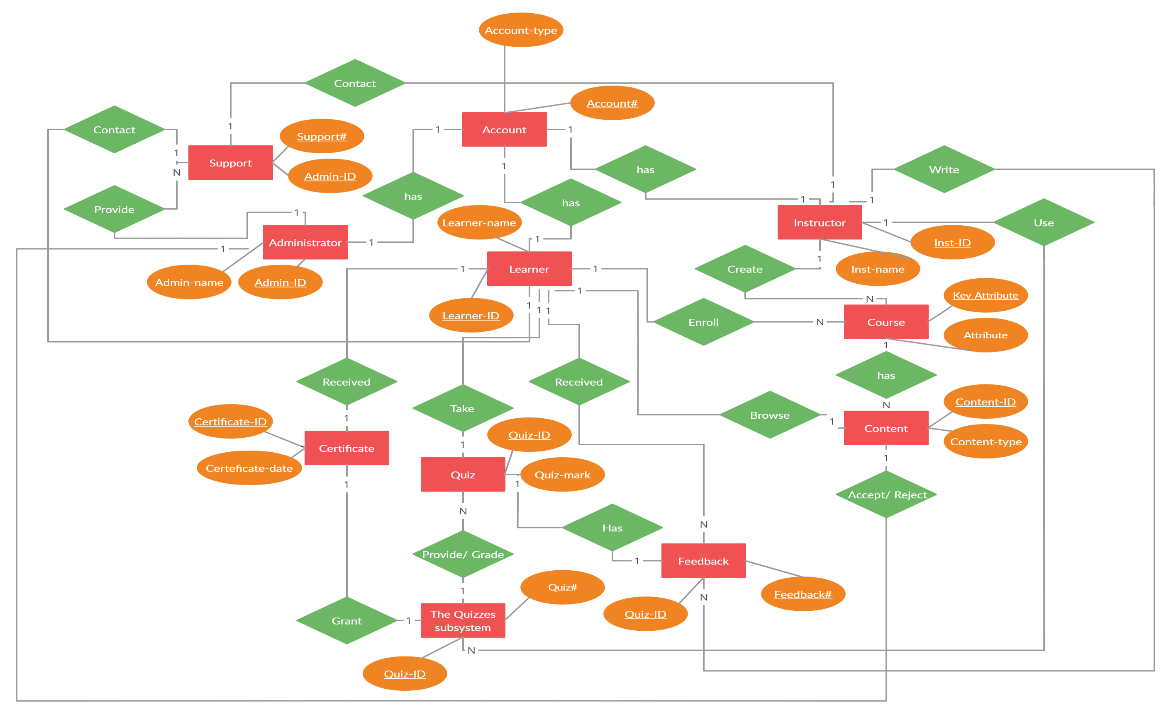
ER Diagram

Slide 21
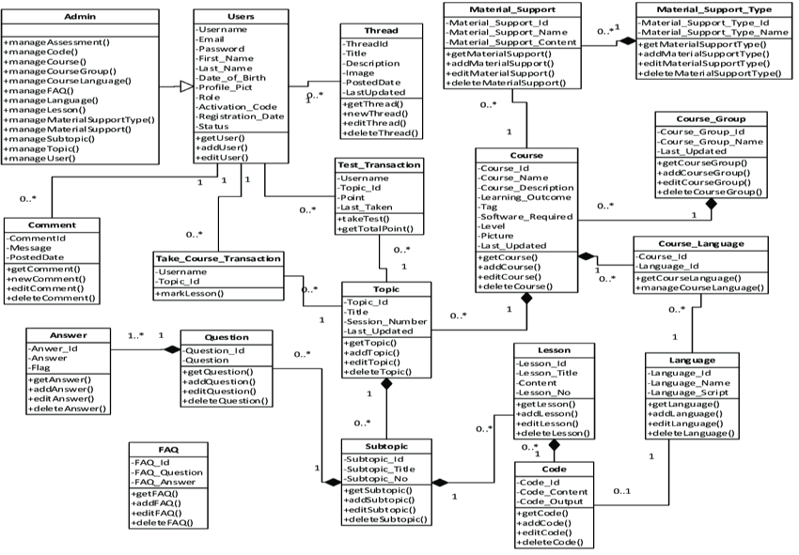
Class Diagram

Slide 22
Application Modeling
Courses, Professors, and Students list.
Maintaining and monitoring the professors and student's profile.
Communication channels.
Maintaining and monitoring courses content up-to-date.
Looking into Accounts.
Admin
QuickLearning App
Upcoming schedules.
List of courses.
Uploading course related contents.
Uploading quizzes and exams.
Give feedbacks.
Monitoring the student's progress.
Special Classes.
Add course sections.
Review revenue.
Communication channels.
Authentication & Authorization
Professor
List of courses.
Weekly schedule.
Personal profile.
Upload write exams & submit quizzes.
Marks.
Downloads.
Saving course materials offline.
Communication channels.
Courses payment details.
Student

Slide 23
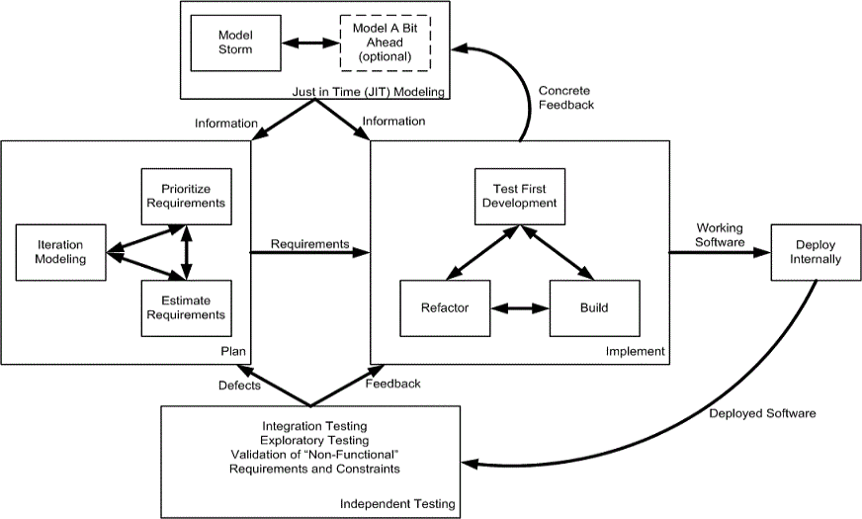
Agile Software Development Process

Slide 24

Sprint Recap

Slide 25
Sprint 1-4 Recap
Gathered Requirements about the project.
Designed Database.
User registration for QuickLearning app.
User login and logout for QuickLearning app.
Admin, Instructor and Student course access.
Wishlist for the student role to save the courses.
Sending messages within the website.
Guest user search bar and top 10 courses.

Slide 26
Sprint 5-7 Recap
Admin system settings.
User can see the content in different languages.
Admin enrolling the students to the courses.
Admin revenue and course-wise revenue report.
Admin/Instructor can add categories.
Payment for courses.
Admin can make course active or pending.
Professor course-wise revenue report.
Revenue chart of every month on Admin dashboard.

Slide 27
Project Recap
FUNCTIONALITIES FOR ADMIN
Dashboard With Revenue Chart, Number of Courses, Number of Lessons, Number of enrollments, and Number of students.
Categories include Category and also Add New category wherein the list of categories will be seen.
The courses section will display Active Courses, Pending Courses, Paid Courses, and Free Courses and a List of Courses that are chosen.
The student section will display details about the student which is name, photo, email, and the courses in which he/she is enrolled.
The enrollment section will display the enrollment form in which User is displayed and he/she can choose the course.
Admin has the right to update and delete the courses according to the status.
FUNCTIONALITIES FOR INSTRUCTOR
For the Courses section (Active, Pending, Draft, Free, Paid ), Courses will be displayed and the course list can be viewed.
Instructor can also add a new course.
The instructor has my account page where they can edit their information.
Instructor revenue can be viewed from the instructor dashboard.
FUNCTIONALITIES FOR STUDENT
Student Profiles will display All courses(In which they are enrolled), Wishlist, Purchase History, and User Profile.
Students can filter by categories and view the courses in which he/she is enrolled.
Students can take quizzes on Particular Courses.
The payment section will include a payment window where the purchase can be done with PayPal, Credit/Debit Card.

Slide 28
Product Backlog
ID | Issue Type | Story | Status | Story Points | Priority
BREW-117 | Story | As an admin, I want to be able to add different information to my profile, so that I can create a personalized dashboard that reflects my preferences and needs. | Done | 1 | High
BREW-132 | Story | As a professor, I want to create different sections in my course, so that I can upload and organize different learning materials for each section, and students can easily access and navigate through the course content based on their needs. | Done | 2 | High
BREW-133 | Story | As a professor, I want to upload course materials for my students, so that they can review them at their convenience. | Done | 5 | High
BREW-134 | Story | As a student, I want to download course materials, so that I can review them both online and offline at my convenience from anywhere. | Done | 5 | High
BREW-141 | Story | As a professor, I want to create quizzes for my students to assess their understanding of various topics and evaluate their knowledge base. | Done | 5 | High
BREW-142 | Story | As a student, I want to take quizzes to verify my knowledge base and test my understanding of various topics, so that I can identify areas where I need to improve my understanding and work on them accordingly. | Done | 5 | High

Slide 29
Sprint Backlog
User Story ID | Summary | Story Point
BREW-117 | As an admin I want to add different informational to my profile So that I create a personalized dashboard that reflects my preferences and needs | 1
BREW-132 | As a professor I want to create different sections in my course So that I can upload and organize different learning materials for each section | 2
BREW-133 | As a professor I want to upload course materials for my students So that the student can refer to the notes at their convenience | 5
BREW-134 | As a student I want to be able to download course material So that I can review them at my convenience | 5
BREW-141 | As a professor I want to create quizzes for my student So that I can assess their understanding of various topic covered in the class | 5
BREW-142 | As a student I want to take quizzes So that I can verify my knowledge base and test my understanding of various topics | 5

Slide 30
User Stories (1/2)
User Story ID | Acceptance Criteria | Status
BREW-117 | As an admin I want to add different informational to my profile So that I create a personalized dashboard that reflects my preferences and needs | Done
 | Scenario: The admin wants to add information to their profile Given the admin is logged in using the correct credentials When the admin navigates to their profile section, then the admin can add different types of information, such as their name, contact details, profile picture, and any other relevant information And the admin can save the changes to their profile
BREW-132 | As a professor I want to create different sections in my course So that I can upload and organize different learning materials for each section | Done
 | Scenario: The professor wants to create sections in their course Given the professor is logged in using the correct credentials When the professor navigates to the course creation section Then the professor can create different sections in the course, such as introduction, main topics, and conclusion And the professor can upload and organize different learning materials such as videos, articles, and presentations, for each section
BREW-133 | As a professor I want to upload course materials for my students So that the student can refer to the notes at their convenience | Done
 | Scenario: The professor wants to upload course materials for their students Given the professor is logged in using the correct credentials When the professor navigates to the course material section Then the professor can upload different course materials such as lecture notes, video url, slides, and readings, for the students to access And the professor can organize the course materials by topics or sections for ease of access

Slide 31
User Stories (2/2)
User Story ID | Acceptance Criteria | Status
BREW-134 | As a student I want to be able to download course material So that I can review them at my convenience | Done
 | Scenario: The student wants to download course material Given the student is logged in using the correct credentials When the student navigates to the course material section Then the student is able to download the desired course material and save it on their device And the student can access and review the downloaded material at their convenience
BREW-141 | As a professor I want to create quizzes for my student So that I can assess their understanding of various topic covered in the class | Done
 | Scenario: The professor wants to create quizzes for their students Given the professor is logged in using the correct credentials When the professor navigates to the quiz creation section Then the professor can create a new quiz, provide a title, and set the duration and difficulty level of the quiz And the professor can add different types of questions such as multiple choice, true/false, fill in the blanks, or short answer questions
BREW-142 | As a student I want to take quizzes So that I can verify my knowledge base and test my understanding of various topics | Done
 | Scenario: The student wants to take quizzes Given the student is logged in using the correct credentials When the student navigates to the quiz section Then the student can choose the quiz they want to take from the available options And the quiz can include different question types such as multiple choice, short answer, and more

Slide 32
Test Cases

Slide 33
Stories Completed and Stories Not Completed
User Story ID | Summary | Story Point | Status
BREW-117 | As an admin, I want to be able to add different information to my profile, so that I can create a personalized dashboard. | 1 | Completed
BREW-132 | As a professor, I want to create different sections in my course, so that I can upload and organize different learning materials for each section. | 2 | Completed
BREW-133 | As a professor, I want to upload course materials for my students, so that they can review them at their convenience. | 5 | Completed
BREW-134 | As a student, I want to download course materials, so that I can review them both online and offline at my convenience from anywhere. | 5 | Completed
BREW-141 | As a professor, I want to create quizzes for my students to assess their understanding of various topics and evaluate their knowledge base. | 5 | Completed
BREW-142 | As a student, I want to take quizzes to verify my knowledge base and test my understanding of various topics, so that I can identify areas where I need to improve. | 5 | Completed

Slide 34

Metrics

Slide 35
Team Velocity Chart
25
20
15
10
5
0
Sprint 1
Sprint 2
Sprint 3
Sprint 4
Sprint 5
Sprint 6
Sprint 7
Sprint 8

Slide 36
Team Historical Velocity (Average)
25
23
23
20
19
15
15
15
14
14
10
7
5
5
0
Sprint 1
Sprint 2
Sprint 3
Sprint 4
Sprint 5
Sprint 6
Sprint 7
Sprint 8
Average

Slide 37
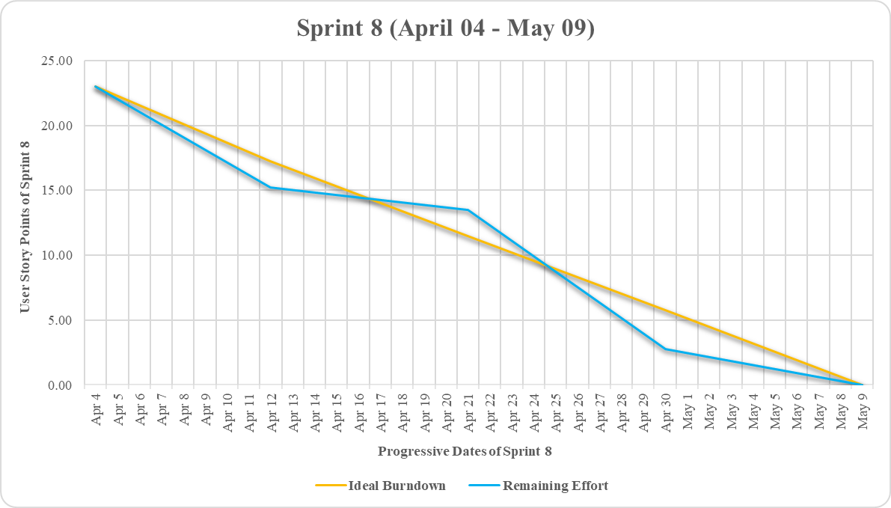
Burndown Chart

Slide 38
Committed Against Completed Ratio
Sprint Number | Committed | Completed
Sprint 1 | 5 | 5
Sprint 2 | 7 | 7
Sprint 3 | 15 | 15
Sprint 4 | 14 | 14
Sprint 5 | 14 | 14
Sprint 6 | 23 | 23
Sprint 7 | 19 | 19
Sprint 8 | 23 | 23
Committed
100%
Completed
100%

Slide 39

Retrospective

Slide 40
What went well?
Having open and honest discussions among team members on how to improve together is a crucial element in fostering a strong team dynamic.
By being transparent in their communication, the team was able to develop a shared understanding and expectation, which in turn helped build a sense of unity.
The team's deep involvement and awareness of each other's perspectives led to valuable and unexpected outcomes.
The team frequently experimented with new approaches and conducted regular retrospectives to evaluate their effectiveness.

Slide 41
What did not go well?
Being proactive in problem-solving and quickly resolving technical challenges was essential for keeping up with sprint timelines.
We faced some inefficiencies in our testing process, leading to the need for last-minute bug fixes.
We faced difficulty in accurately estimating the subtasks that arose during the sprint.

Slide 42
What needs improvement?
To minimize delays, it is important to establish a process for proactive problem-solving.
Involving QA earlier in the development process can be an effective way to enhance our testing process.
To better manage our sprint, it is important to estimate all subtasks at the beginning of the sprint.

Slide 43

Improvements Made (All Sprints)
Performed Unit Testing to avoid bugs that we we were facing.
Learned and created diagrams for the Project.
Used a more accurate way to estimate the story size and got better at estimation.
Guaranteed that all user stories have clear acceptance criteria before picking them up and Used a more accurate way to estimate the story size.
We improved our testing process by involving QA earlier in the development process and estimated all the sub task at the starting of the sprint.
User testing is developed properly in the sprint, and we held meetings only when we needed to.

Slide 44

Slides App Screenshot

Slide 45
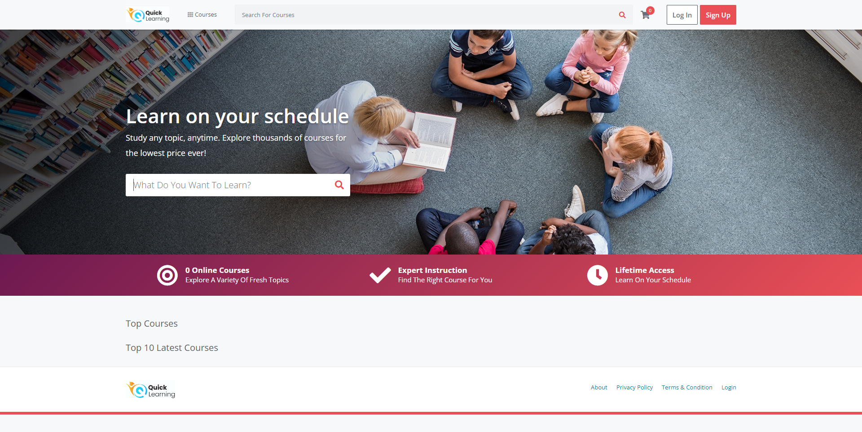
Home Page with Search Bar to search for courses

Slide 46
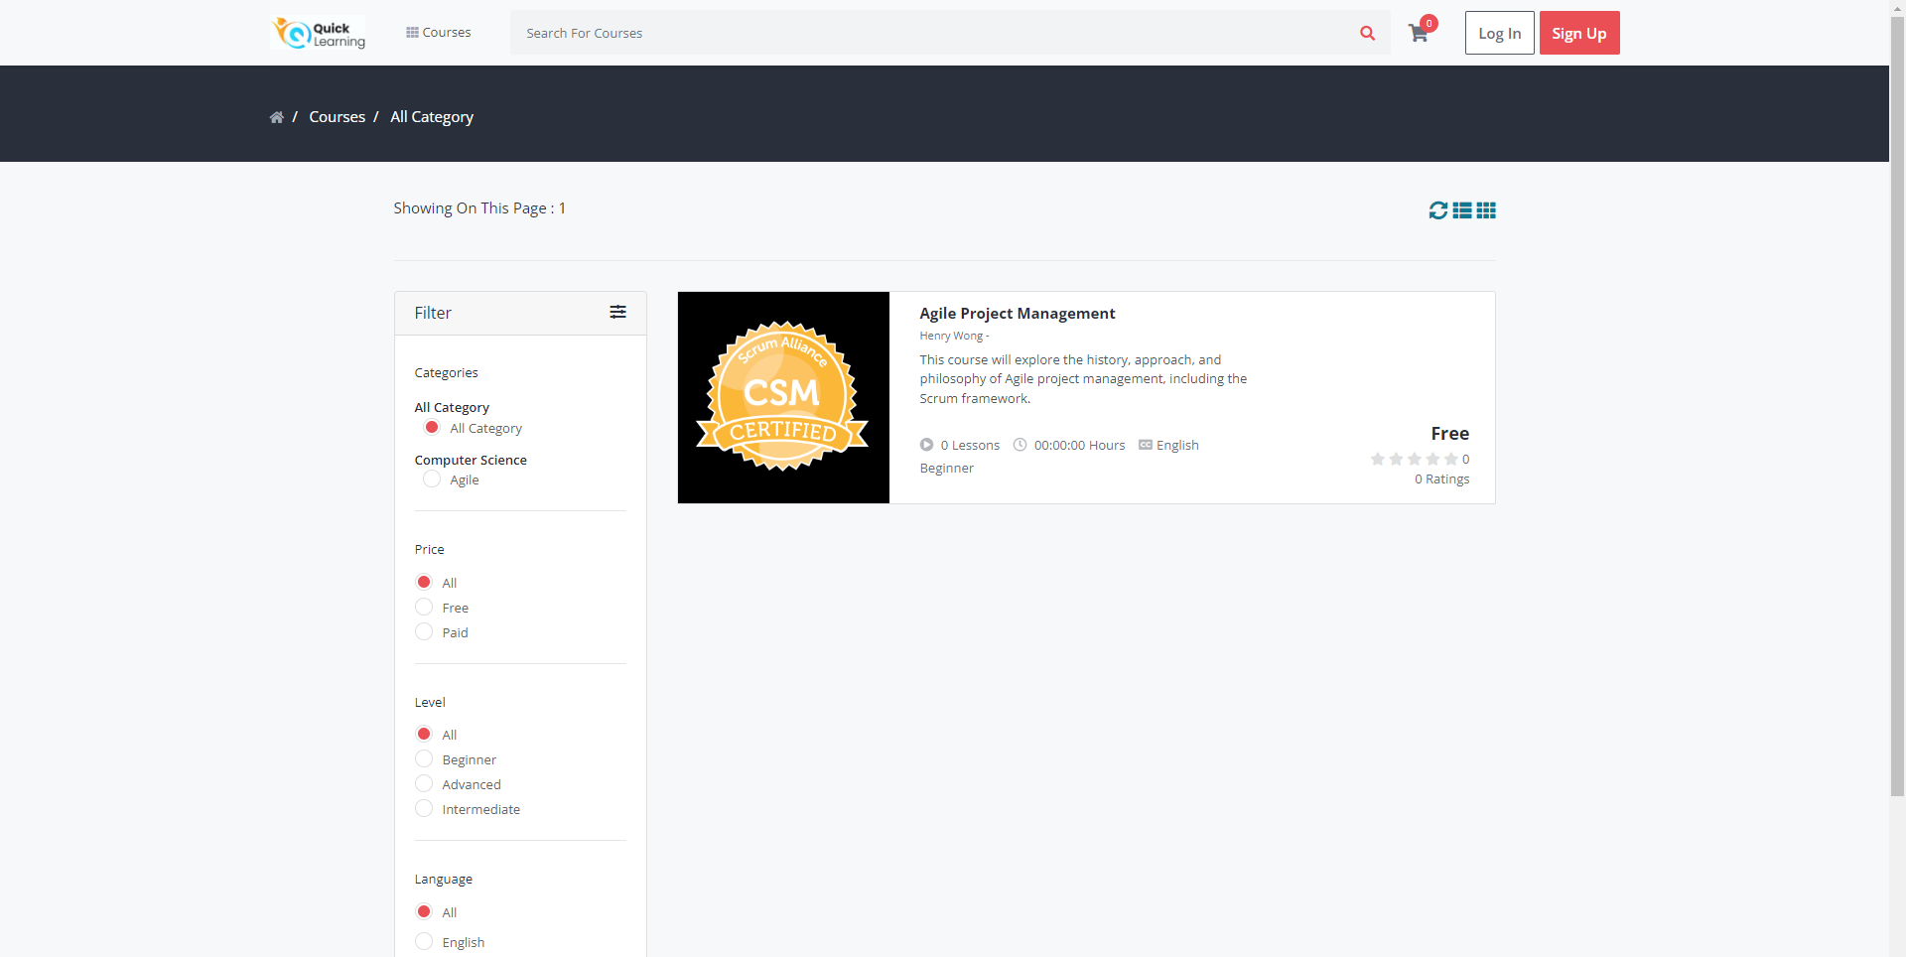
Search Courses as Guest

Slide 47
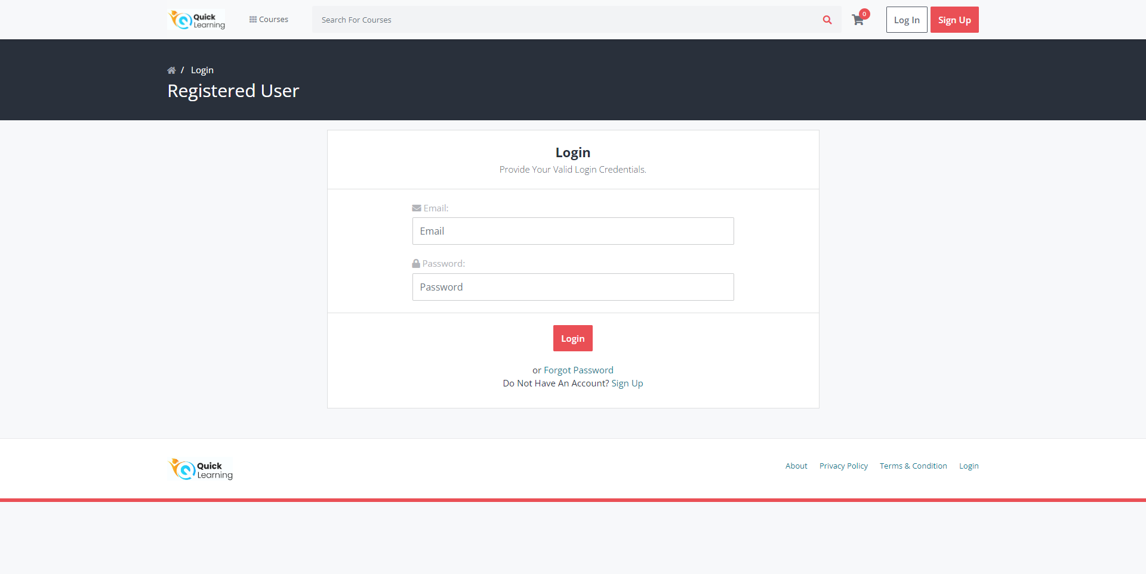
Login Page

Slide 48
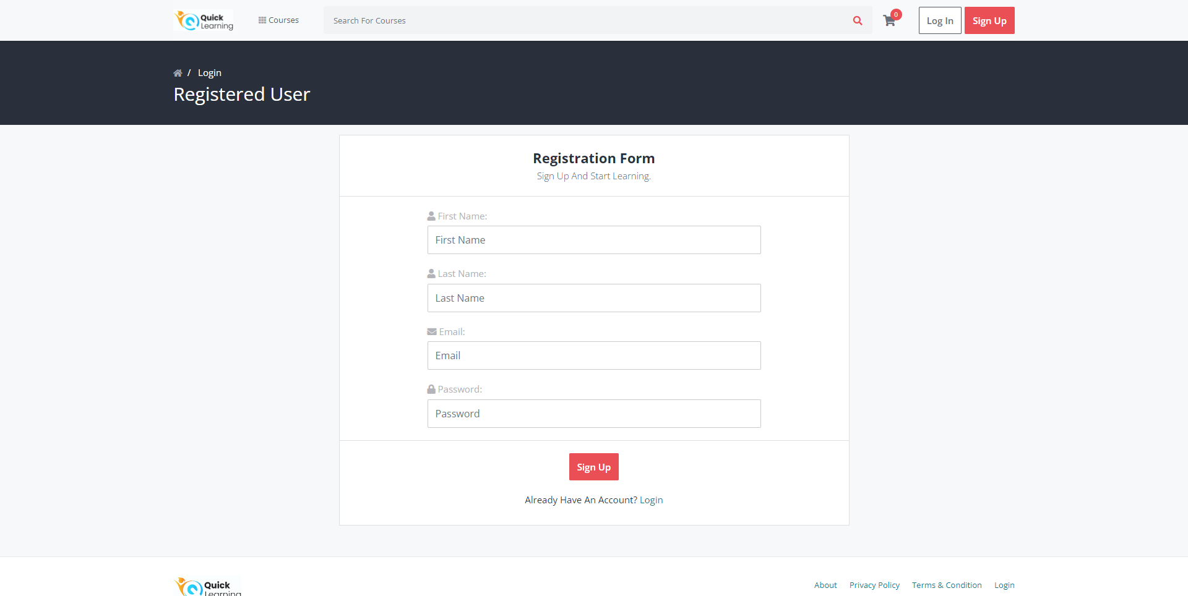
SignUp Page

Slide 49
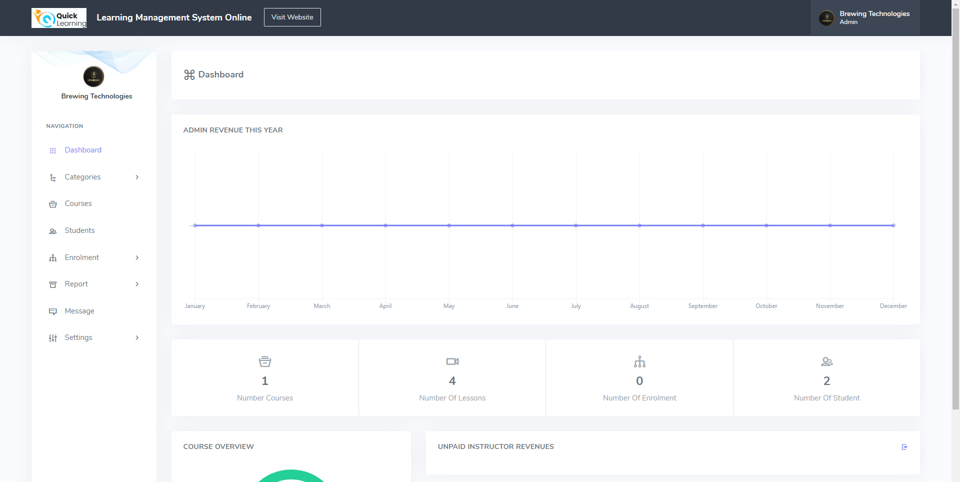
Admin Dashboard

Slide 50
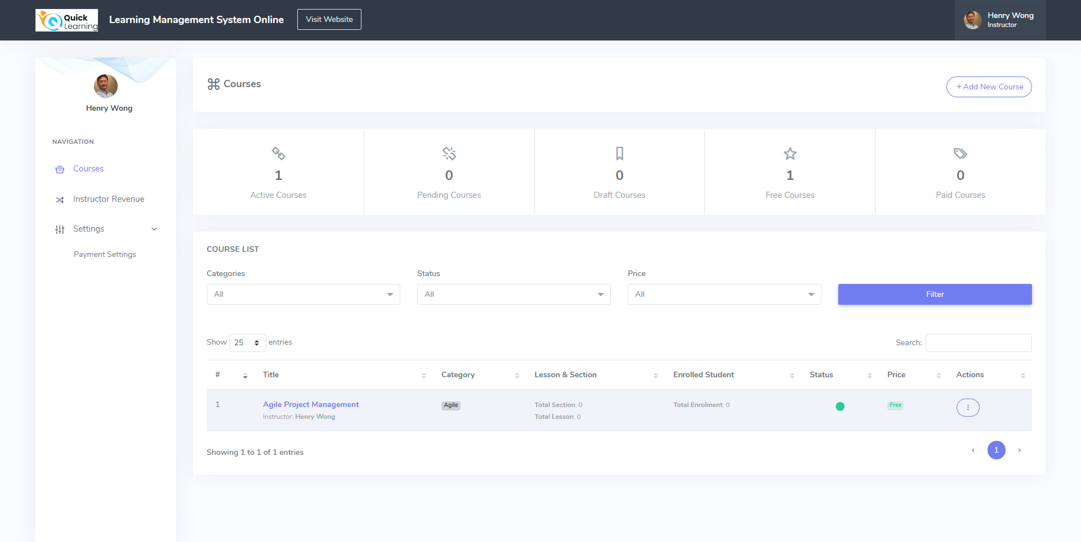
Instructor/Professor Dashboard

Slide 51
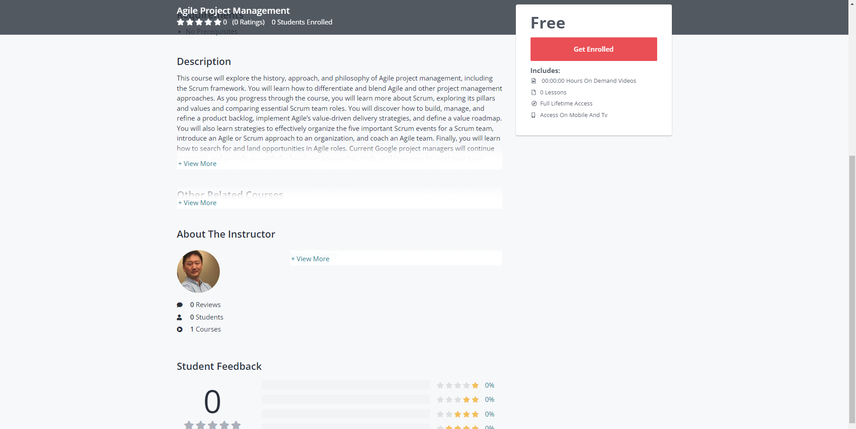
Course Page

Slide 52
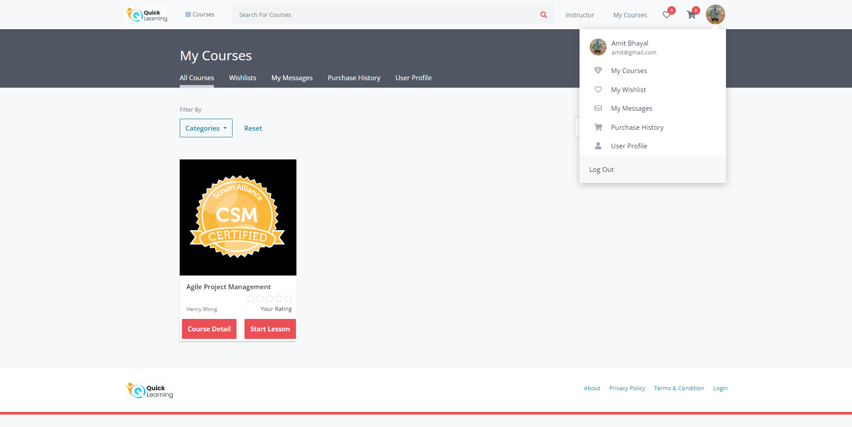
My Courses Page for Student

Slide 53
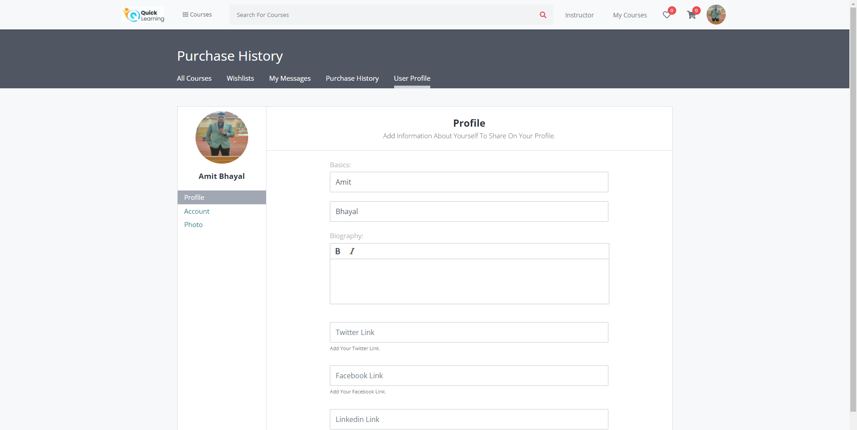
My Profile Page

Slide 54
Visit our WikiLink
https://github.com/htmw/QuickLearning/wiki
https://github.com/BrewingTechnologies/QuickLearning/wiki

Slide 55

Live Application Demo

Slide 56
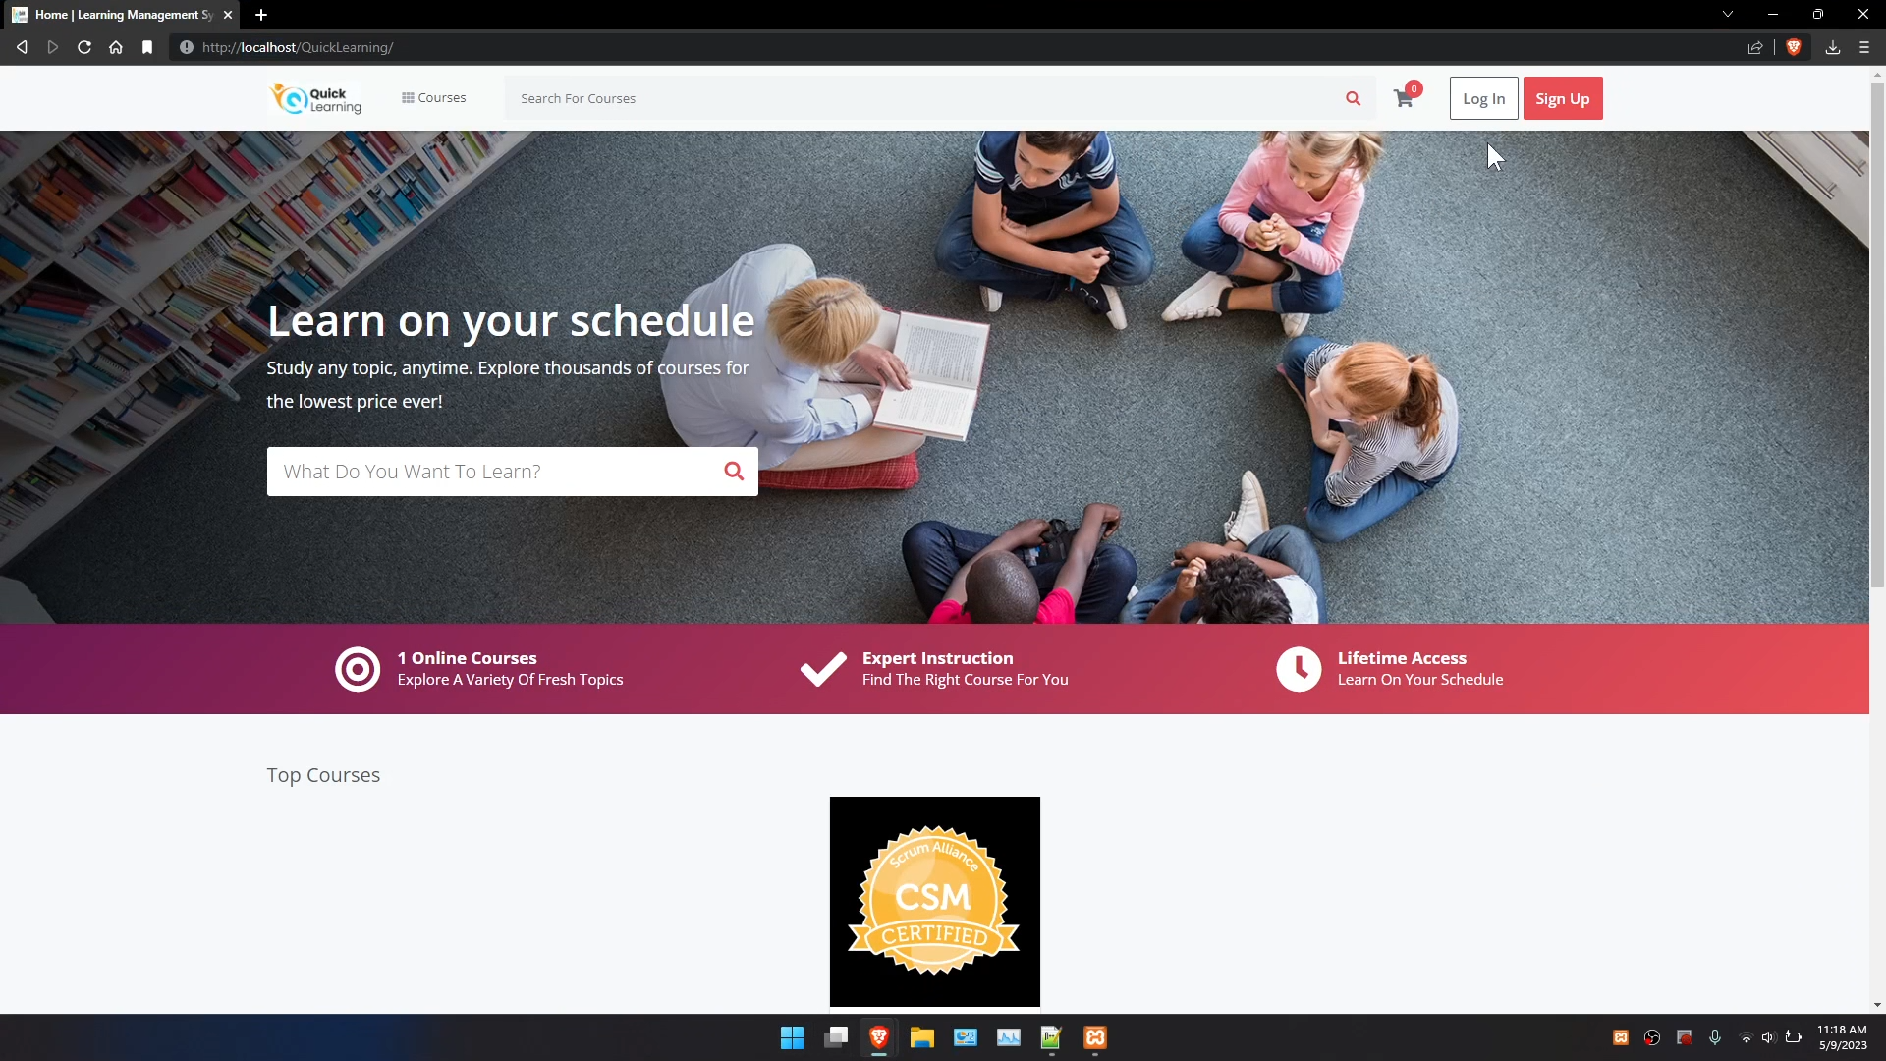

Slide 57

Happy Learning! Thank You for your patience and attention!

